Slide 1
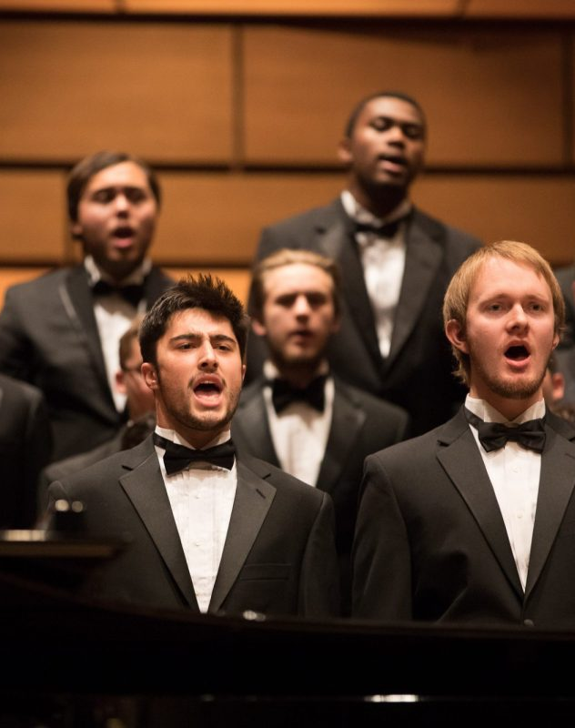
VOICE
HARMONIZER
Computer Music Language and Systems - Homework 3
Politecnico di Milano a.a. 2020/2021
E. Castelli - E. Intagliata - A. Rizzitiello - G. Zanocco

Slide 2
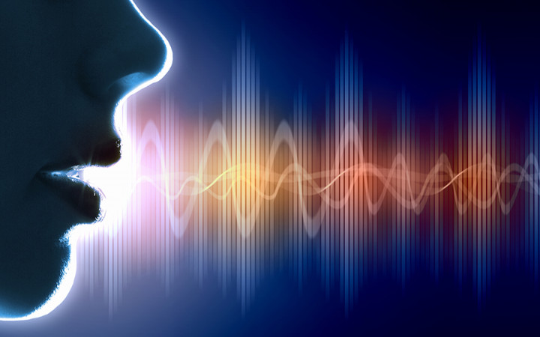

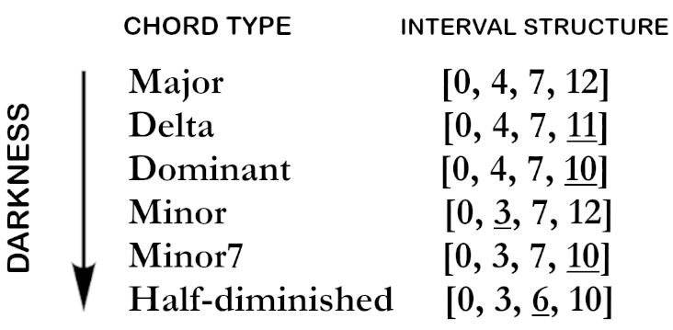

VOICE AND HARMONY
- Voice in polyphonic form
- Quadriads from major
scale harmony
- Interval structure and
«darkness scale»

Slide 3


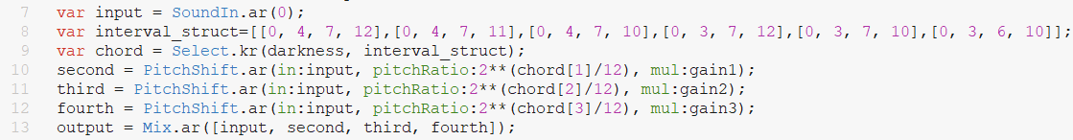
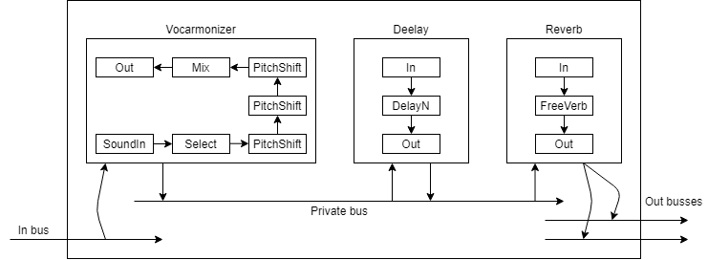
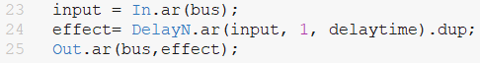
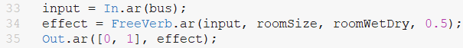
IMPLEMENTATION
\vocarmonizer
\delay
\reverb

Slide 4
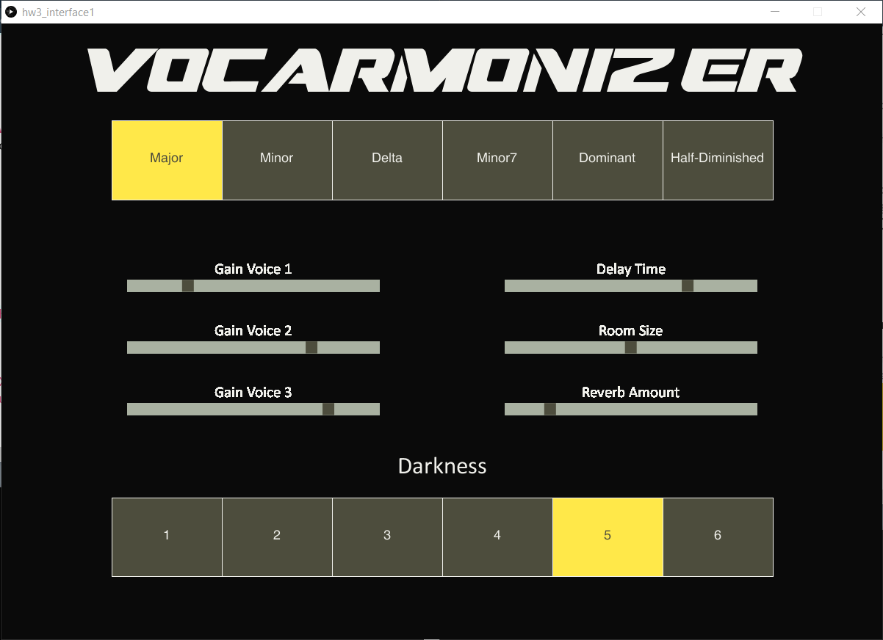

GUI
- Chord type
- Gain of each voice
- Delay time
- Room size
- Room wet/dry
- Darkness scale

Slide 5
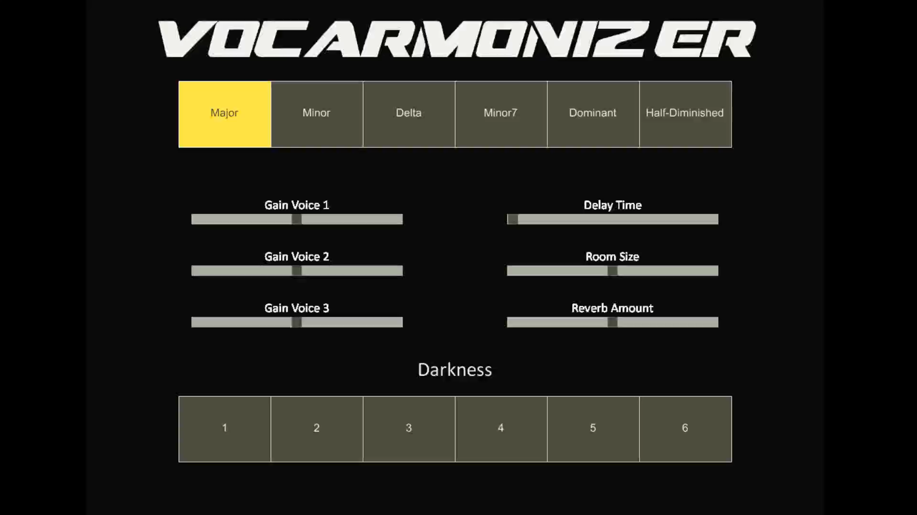
DEMO

Slide 6
FUTURE WORK
Artistic improvements:
- new types of «exotic» chords, with more dissontant tensions
- new spectral and modulation effects (EQ, panning, chorus, tremolo etc.)
Technical improvements:
- ability to record, store and play back your performance
- networking improvements (multiple users interaction)

Slide 7
Thank you for YOUR attention!

